Slide 1
TRUCK
Transportation
Team 5
Kimi Chou
ChuChu Jin
Yueyang Wu

Slide 2

Freight Transportation
Transportation process about large supplies or
commodity goods based on items weight, size and quantity

Slide 3




Advantage
Flexible Service Option
Less Transportation Cost
Easily
Loading / Unloading
Adapt to
Weather Conditions

Slide 4

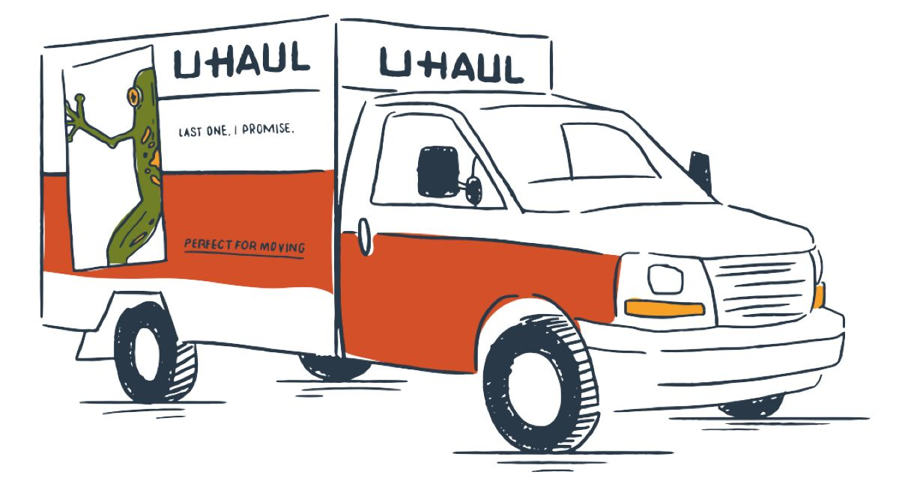


Daily Life
Packages
Furniture, Luggage
01
Delivery Factory
02
Moving Company
03
Construction Company
04
Farmers Market
Brick, cement, lumber
Vegetables, meat

Slide 5
Our Project
We ensure
We need
100%
100%
✔ Real life examples
✔ Save cost
✔ Efficiently load items in truck
✔ Truck Capacity
✔ Item Sizes
✔ Number of Items

Slide 6
User Manual
01
Environment
02
Download Package
Pandas > Store output data into files
Openpyxl > Open excel file
Python > Jupyter Notebook(.ipynb)
Spider(.py)
03
Create a Database
04
Execute Program
Store information
Input user’ data file path and sheetname

Slide 7
Optimization Model in Python
Locate items with a minimum number of trucks

Slide 8
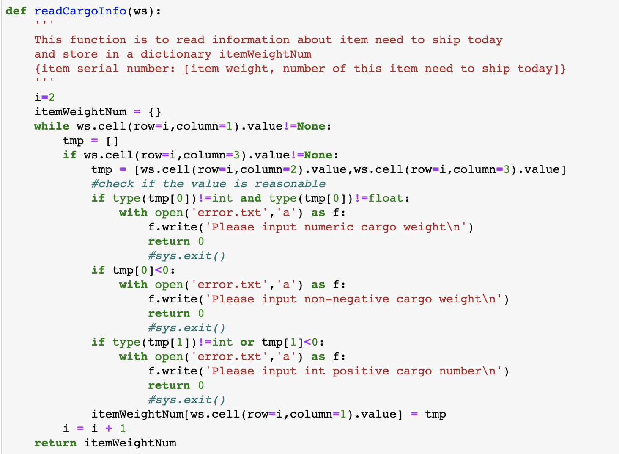
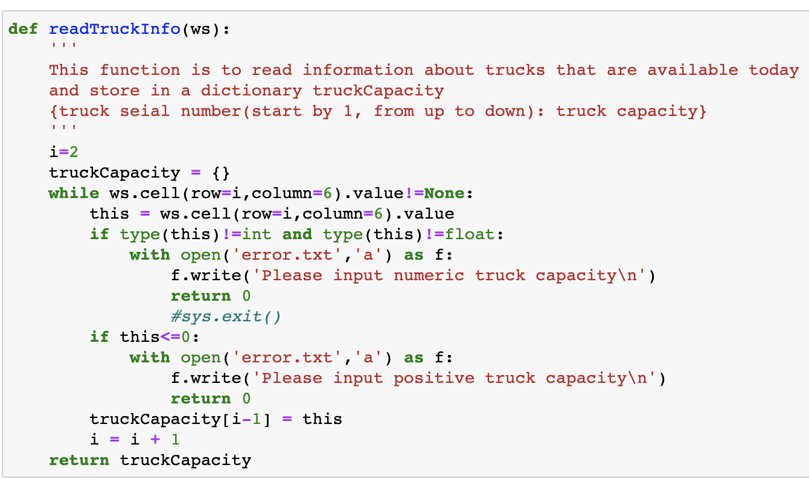
Part I : Read Data

Slide 9
Part 1 : Read Data
Read excel file in main program, pass variable ‘ws’ in these two functions:
readCargoInfo(ws)
Find cargo shipped today, return a dictionary itemWeightNum
The key is the serial number of the cargo, and the value is a list, the first element is the single weight, and the second element is number of item.
readTruckInfo(ws)
Read truck information, return a dictionary truckCapacity.
The key is the serial number of the truck(start from 1), and the value is number, which is the capacity of the truck.
Error.text
Check if the data is reasonable.
If not, write in ‘error.txt’ file and let these two functions return 0.

Slide 10
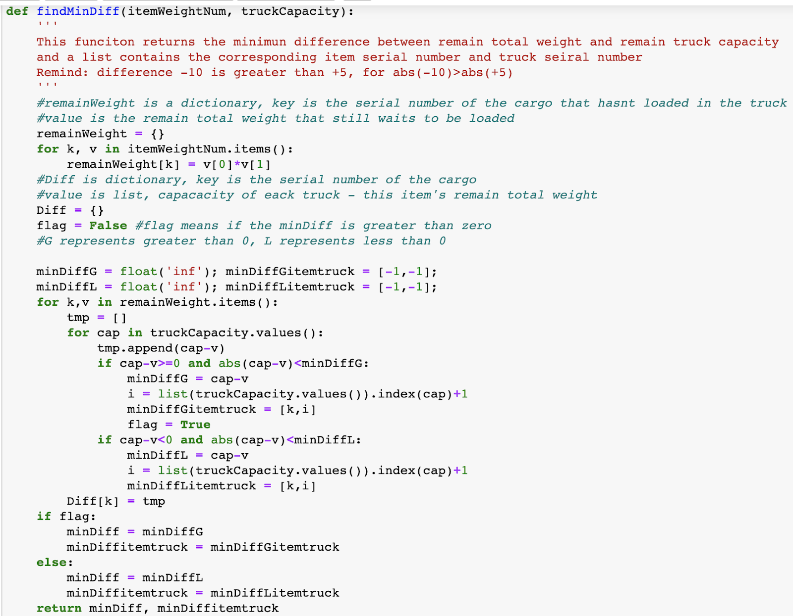
Part 2 : Find Min Difference
findMinDiff (itemWeightNum, truckCapacity):
Use dictionary itemWeightNum and truckCapacity
Find the min difference between items and trucks minDiff (number) and the corresponding item serial number and truck serial number minDiffitemtruck (list)

Slide 11
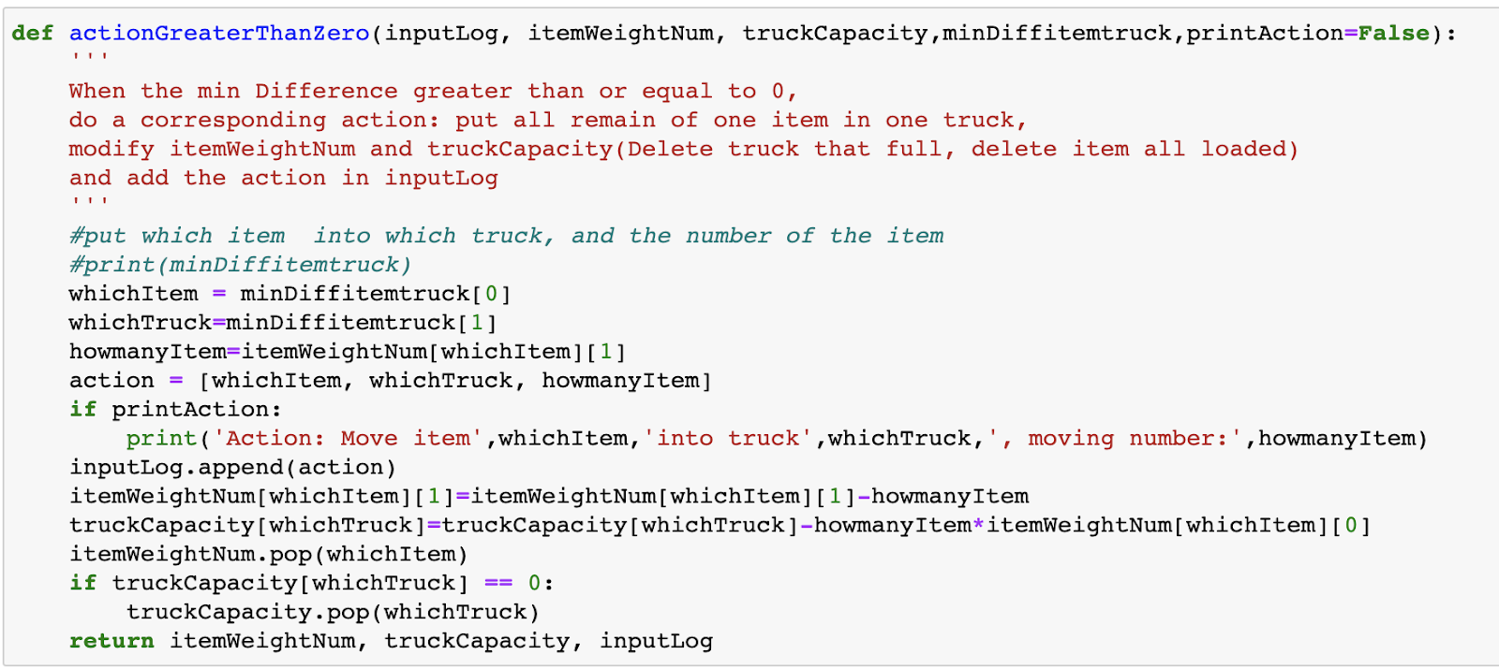
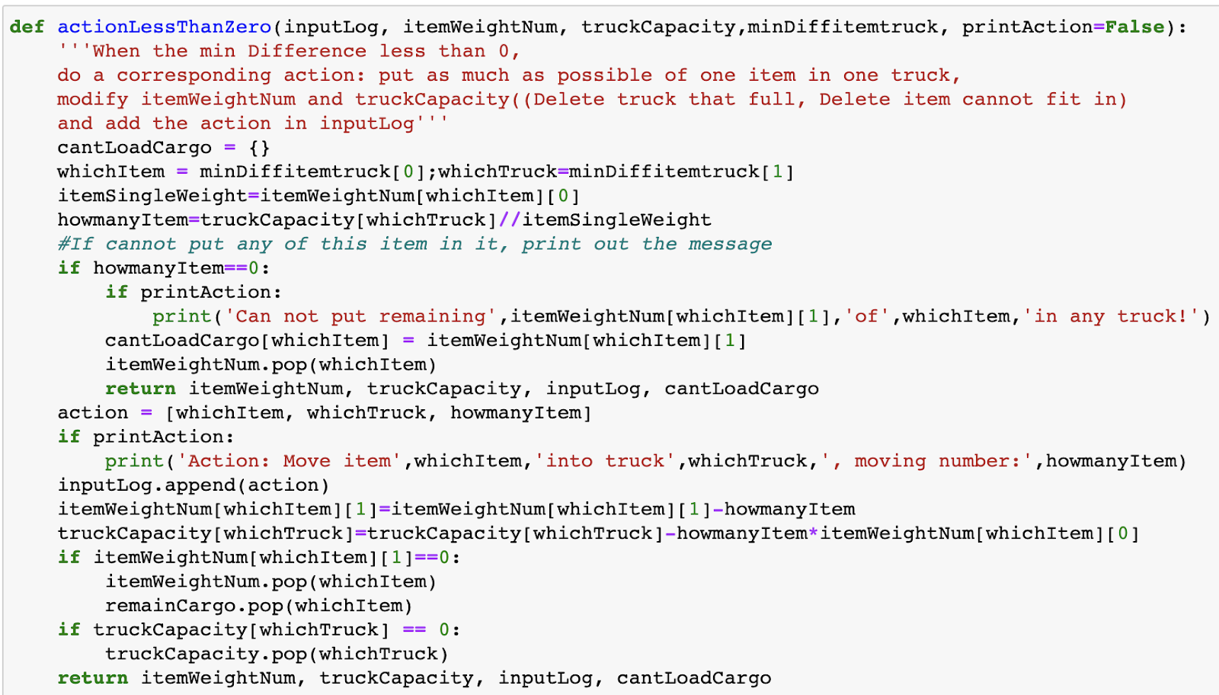
Part 3 : Load Cargo
Situation 1
Situation 2

Slide 12
Part 3 : Load Cargo
actionGreaterThanZero
(inputLog,itemWeightNum,truckCapacity,minDiffitemtruck,printAction=False)
actionLessThanZero
(inputLog,itemWeightNum,truckCapacity,minDiffitemtruck,printAction=False)
minDiff >= 0, means all the remain chosen item can be loaded in the chosen truck
After the action, we delete item from itemWeightNum
Delete truck from truckCapacity if the remain capacity is 0, add the action into inputLog
Return itemWeightNum, truckCapacity, inputLog to be used for next loop.
minDiff < 0, means the remain chosen item cannot all be loaded in the chosen truck
After the action, we delete item from itemWeightNum and store item and number in cantLoadCargo if we cannot put any of it in truck
Delete truck from truckCapacity if the remain capacity is 0, add the action into inputLog
Return itemWeightNum, truckCapacity, inputLog, cantLoadCargo to be used for next loop

Slide 13
Part 4 : Loop Body
Item dictionary is empty
STOP!
Read
Information
Find (New)
Min Difference
Load truck
Modify item info dictionary
Modify truck info dictionary
Modify inputLog
Return inputLog
Return itemWeightNum
Return truckCapacity
Return cantLoadCargo
def loadLoop(ws):
'''
Main loop of the program
'''
itemWeightNum = readCargoInfo(ws)
truckCapacity = readTruckInfo(ws)
inputLog = []
cantLoadCargo = {}
while itemWeightNum! = {}:
minDiff, minDiffitemtruck = findMinDiff(itemWeightNum, truckCapacity)
if minDiff >= 0:
itemWeightNum, truckCapacity, inputLog = actionGreaterThanZero(inputLog, itemWeightNum, truckCapacity, minDiffitemtruck = minDiffitemtruck)
if minDiff < 0:
itemWeightNum, truckCapacity, inputLog, cantLoadCargo = actionLessThanZero(inputLog, itemWeightNum, truckCapacity, minDiffitemtruck=minDiffitemtruck)
return inputLog, itemWeightNum, truckCapacity, cantLoadCargo

Slide 14
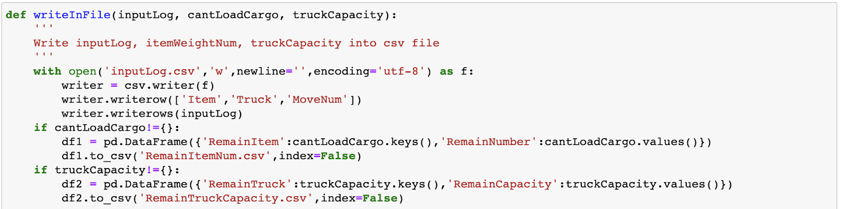
Part 5 : Write File
inputLog.csv
Load action in sequence: Item, Truck, MoveNum
If there is unloaded cargo, the file will exist
Contains the serial number and remain number of the item
RemainItemNum.csv
RemainTruckCapacity.csv
If there is a remain truck capacity, the file will exist
Contains the unfilled trucks and the remain capacity

Slide 15
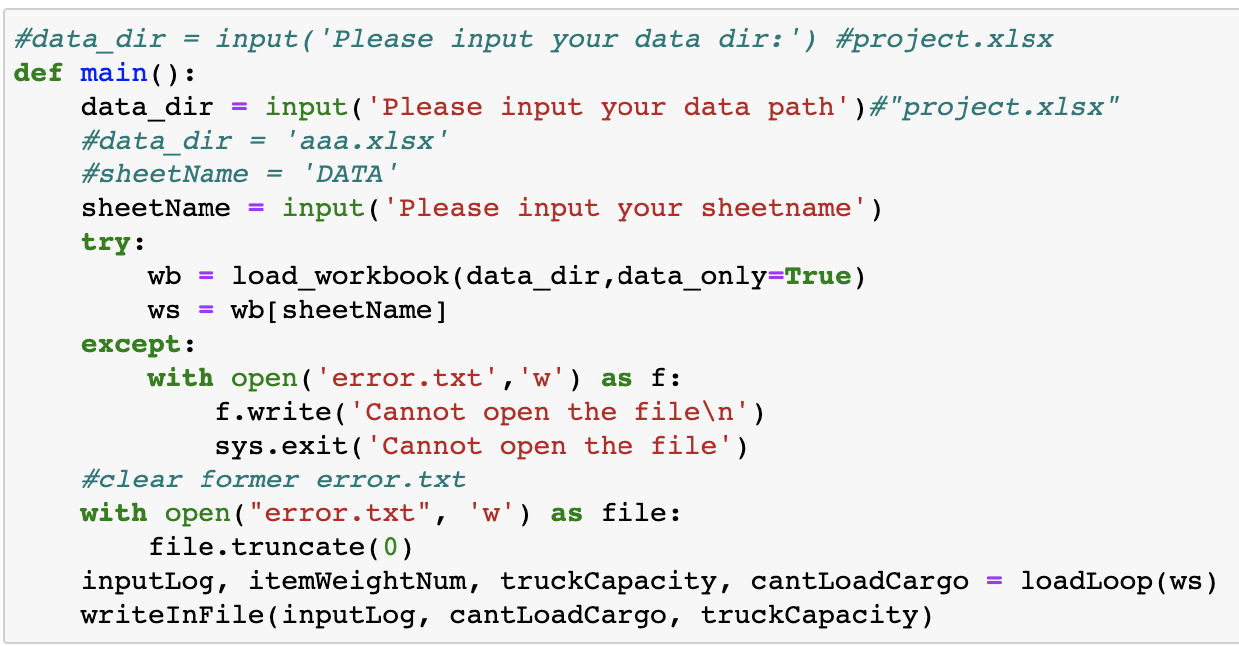
Part 6 : Main Program
Ask user to input ‘data dir’ and ‘sheetname’
Show error.txt if the file cannot open
Clear former error.txt
Call the function

Slide 16
Why Choose This Model ?

Slide 17
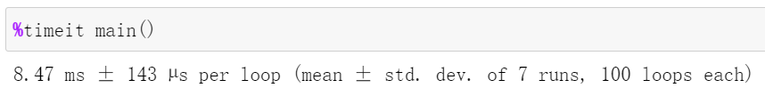
Efficiency of Our Program
01
02
03
04
Small
Memory Space
Short
Running Time
Less
Trucks
Store
Output in File
Reuse variables
% timeit main()
Find minimum
difference
Check data in advance
Store error information

Slide 18
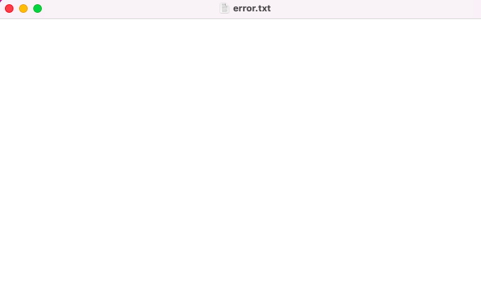
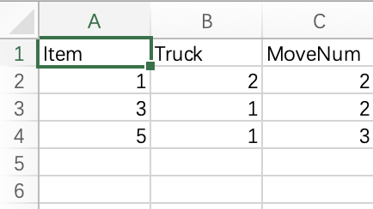
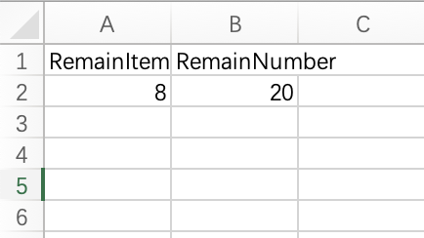
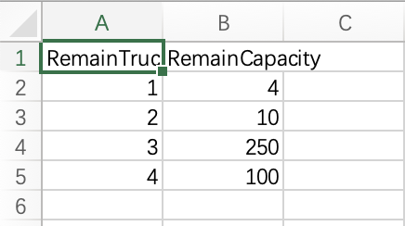
Output of Data
Error.txt
inputLog.csv
RemainItemNum.csv
RemainTruckCapacity.csv

Slide 19
Goals of Our Model
✔ 100% of items are shipped with a minimum trucks covered
✔ Trucks are loaded to their maximum capacity
Help Distribution Manager to…
✔ Consider different items’ characteristics, such as weight
✔ Optimize team with full utilization of drivers and vehicles
✔ Implement the most efficient distribution of available vehicles

Slide 20
Business Values
Reduce logistics costs, Increase profitability
Prevent problems in the supply chain
MODEL
Ensure that delivery deadlines are met

Slide 21
TEAM 5
Thanks for listening

